Slide 1
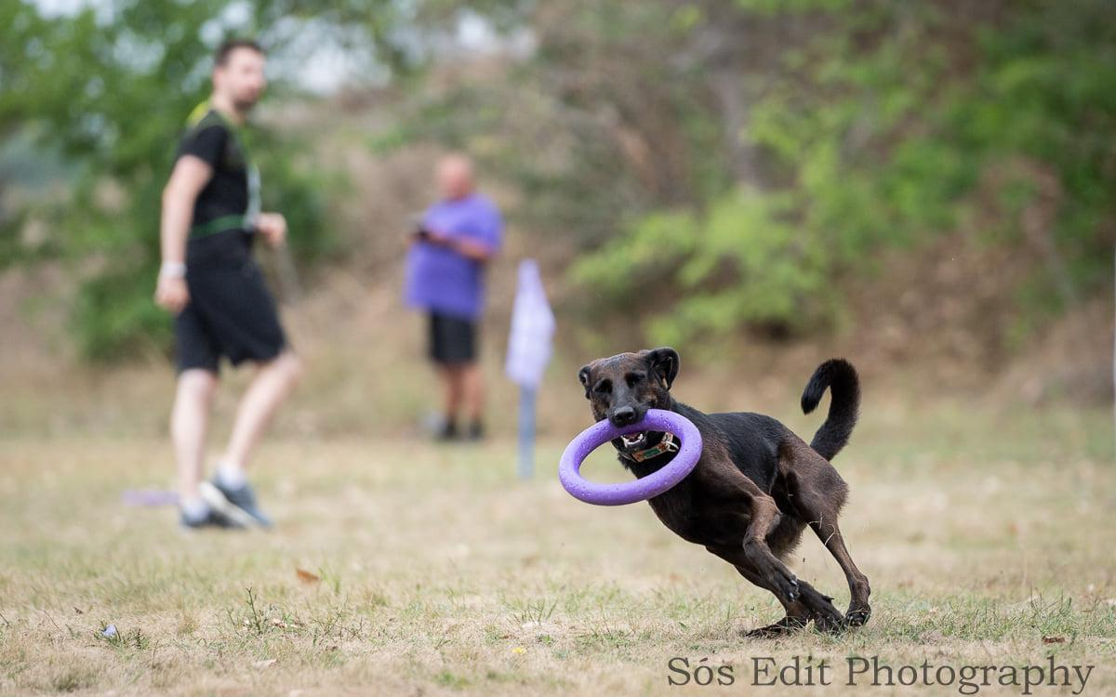
Dog puller

Slide 2
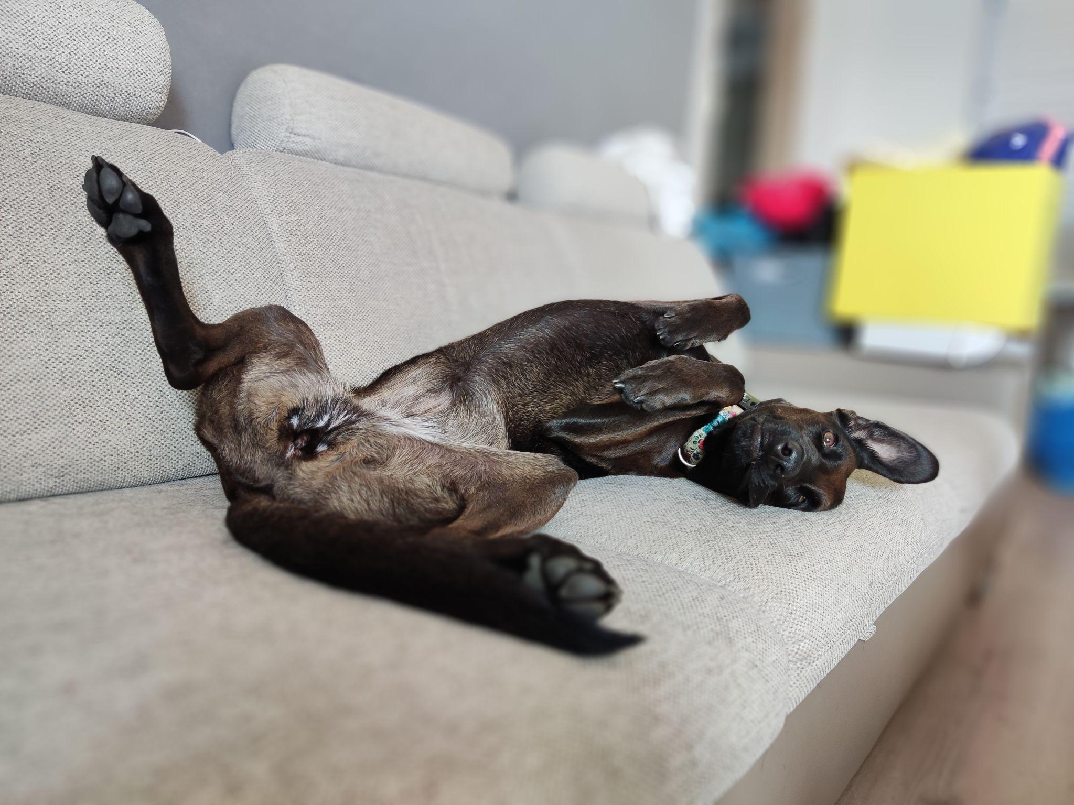
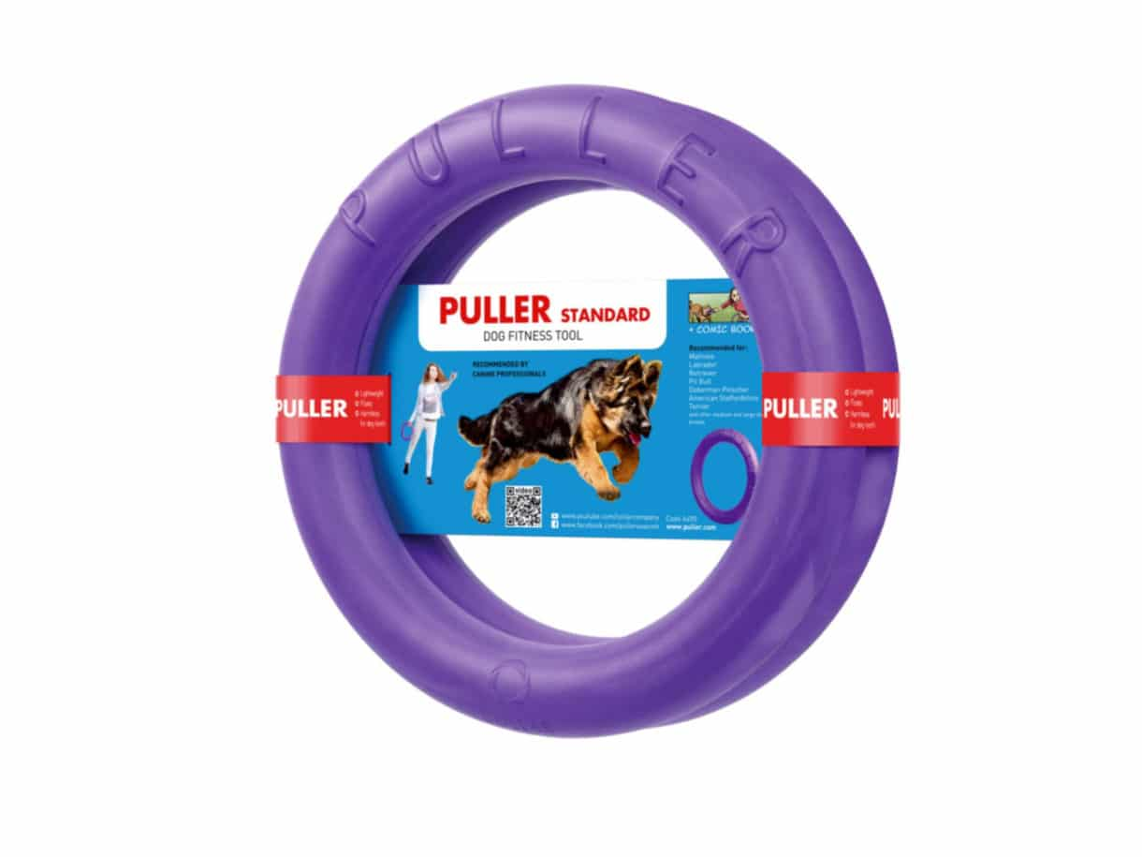
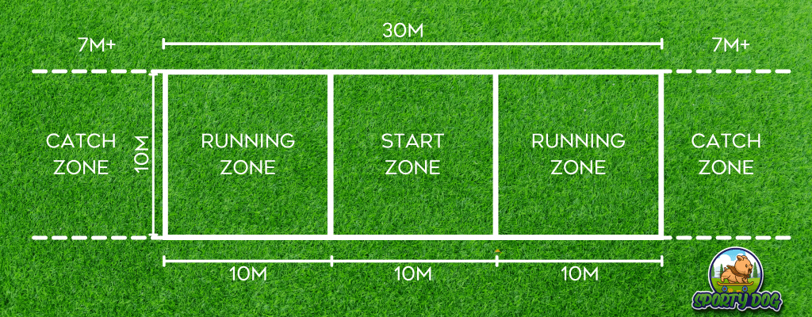
Hobby descriptions

Slide 3
Pros and cons
PROS
Easy to start, it is for everyone!
It strengthens the dog-owner relationship
Keeps you fit
CONS
Could be expensive on higher levels
In some regions It’s hard to find trainers
Injury potential, warming up is a must!

Slide 4
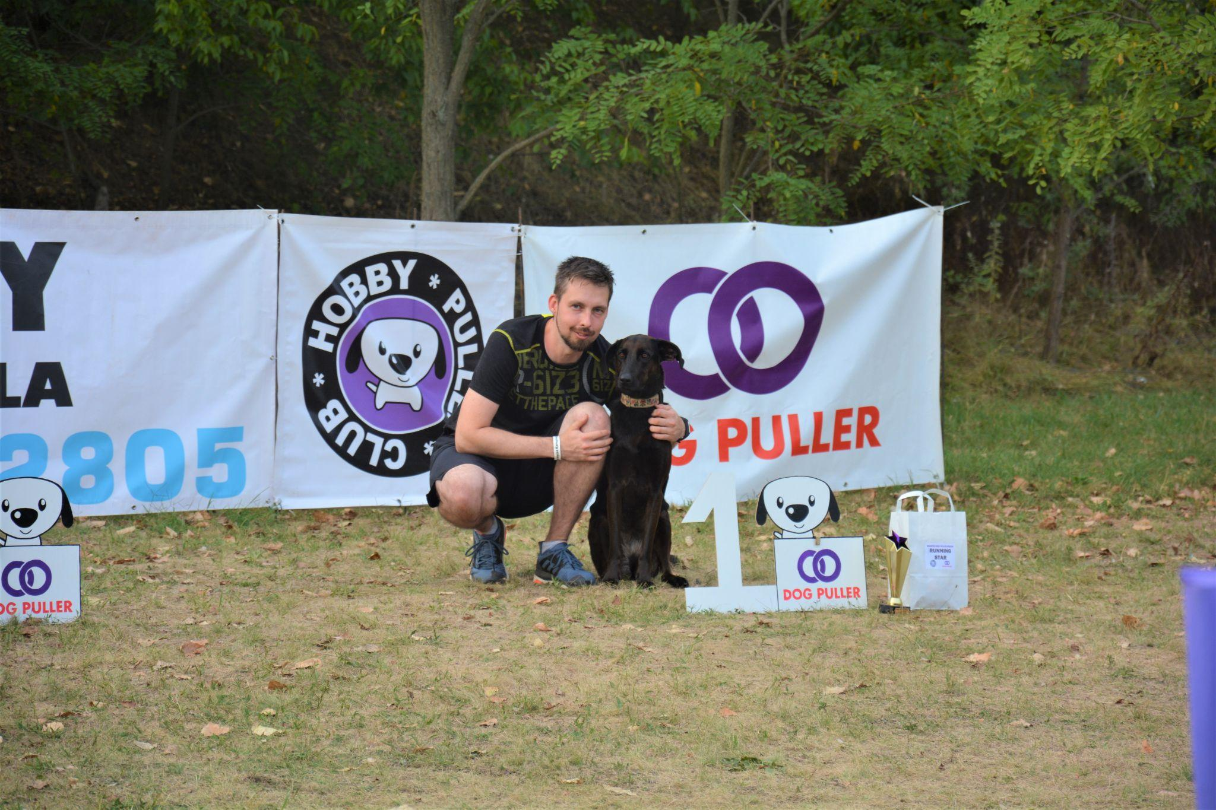
Thank you for listening

